Slide 1
Recipe Preparation Agent
IBM CAPSTONE PROJECT
Presented By:
Abhinav Negi
Graphic Era Deemed to be University
B.Tech CSE (AI & ML)

Slide 2
Problem Statement : 16
Many home cooks struggle with figuring out what meals they can make using the limited ingredients in their kitchen.
Proposed Solution:
An AI-powered Recipe Preparation Agent named CulinaryMind that uses Retrieval-Augmented Generation (RAG) to generate customized recipes using only the ingredients users have on hand.

Slide 3
Technology Used
- IBM Watsonx AI Studio
- IBM Cloud Lite
- IBM Granite Foundation Model
- Retrieval-Augmented Generation (RAG)
- Natural Language Processing (NLP)

Slide 4
IBM Cloud Services Used
- Watsonx AI Studio
- Watsonx Runtime
- IBM Granite LLM
- IBM Cloud Object Storage

Slide 5
Wow Factor
- Reduces food waste and promotes sustainability
- Suggests substitutions and dietary options
- Personalized recipe instructions
- Fast, real-time generation of recipes
- Makes daily cooking smart and efficient

Slide 6
End Users
- Home Cooks
- Students
- Working Professionals
- Health-Conscious Individuals
- Dieticians

Slide 7
Results
- Takes ingredients as input and retrieves relevant recipes
- Provides step-by-step cooking instructions
- Substitution options for missing ingredients
- Adaptability to dietary restrictions

Slide 8
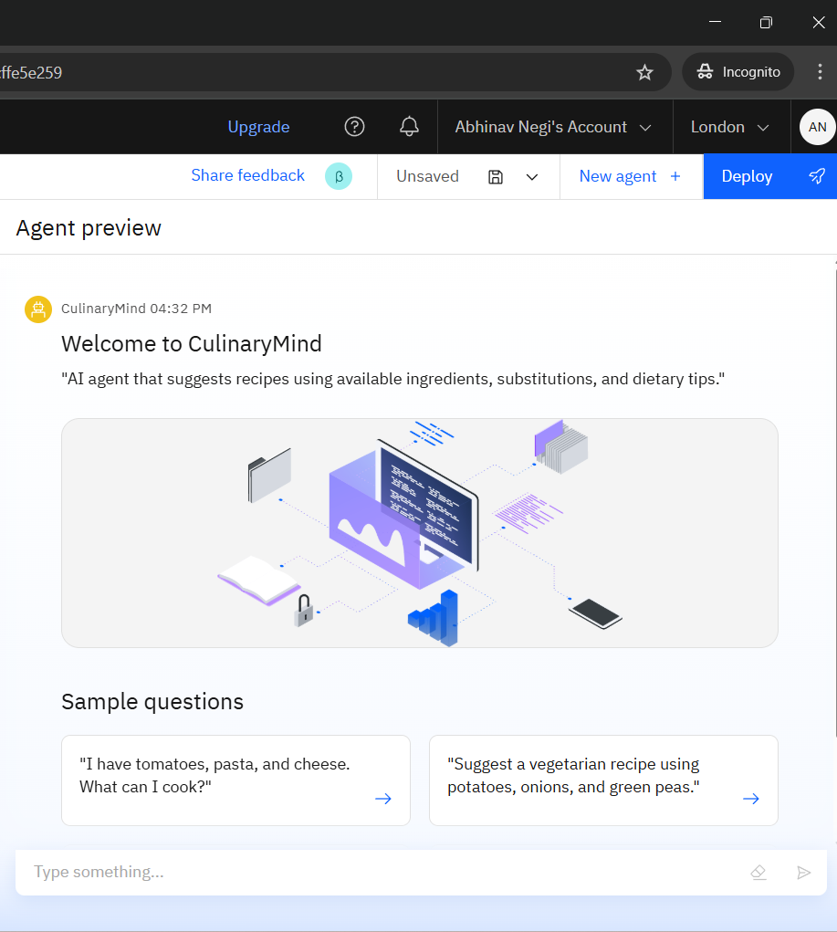

Slide 9
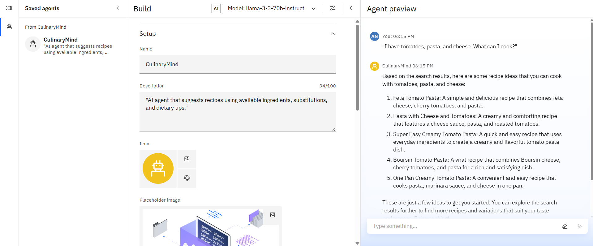

Slide 10
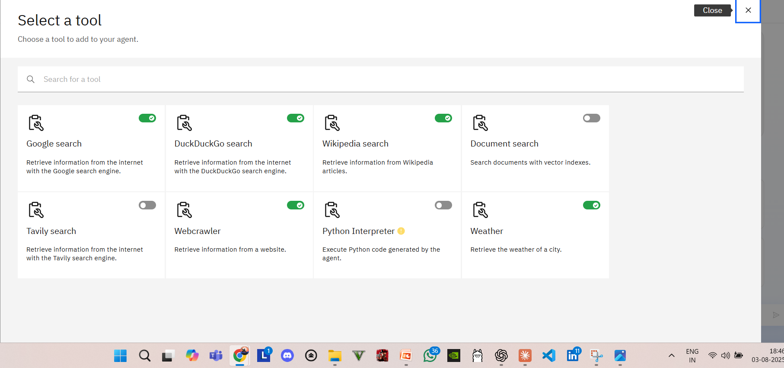
Tools Used

Slide 11
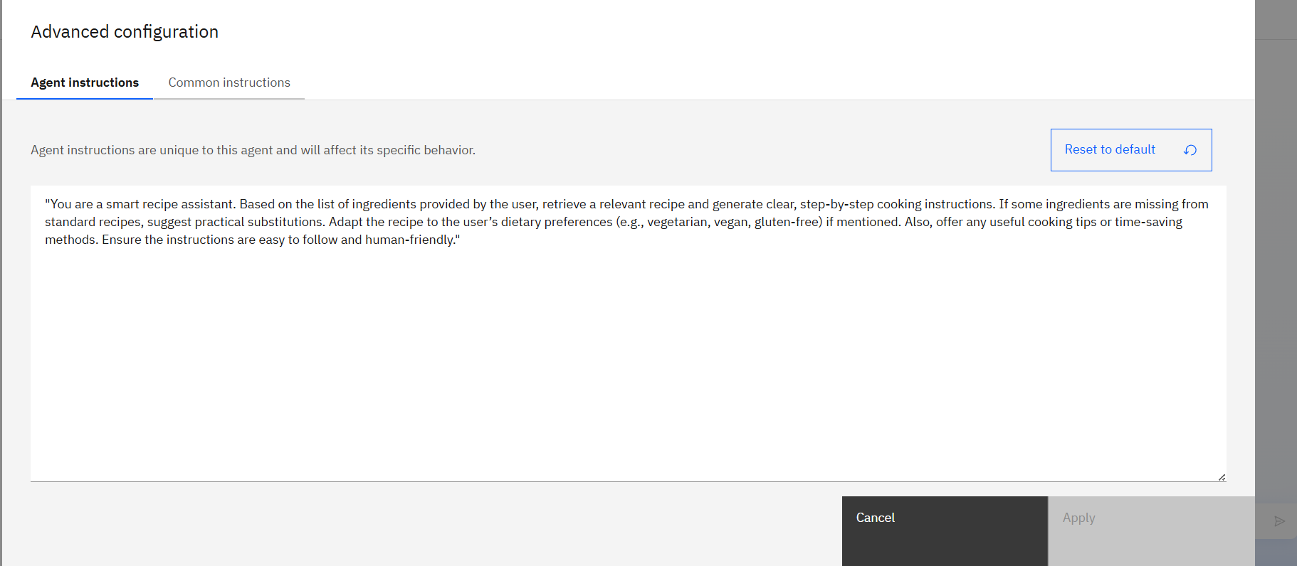

Slide 12
Conclusion
The Recipe Preparation Agent empowers users to cook smarter using AI.
It minimizes waste, adapts to dietary needs, and helps save time — delivering a personalized cooking experience using IBM Watsonx.

Slide 13
GitHub Link:
https://github.com/AbhinavC58/Recipe-Preparation-Agent

Slide 14
Future Scope
- Multilingual recipe generation
- Voice-based assistant integration
- Real-time nutrition calculator
- Meal planning and grocery list integration

Slide 15
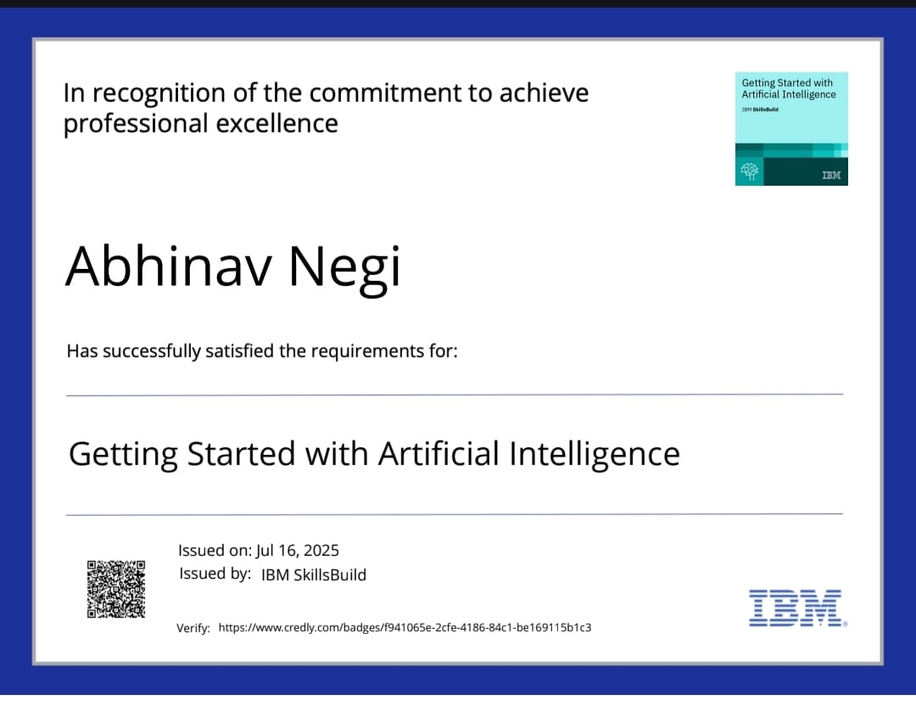
Getting Started with Artificial Intelligence

Slide 16
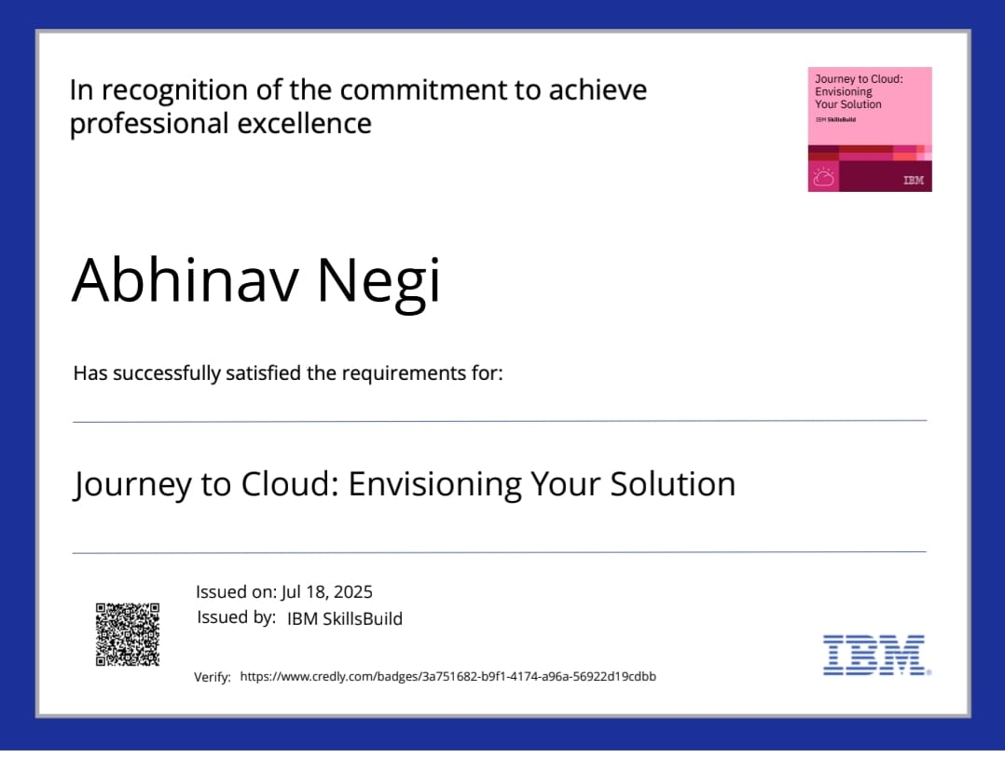
Journey to Cloud: Envisioning Your Solution

Slide 17
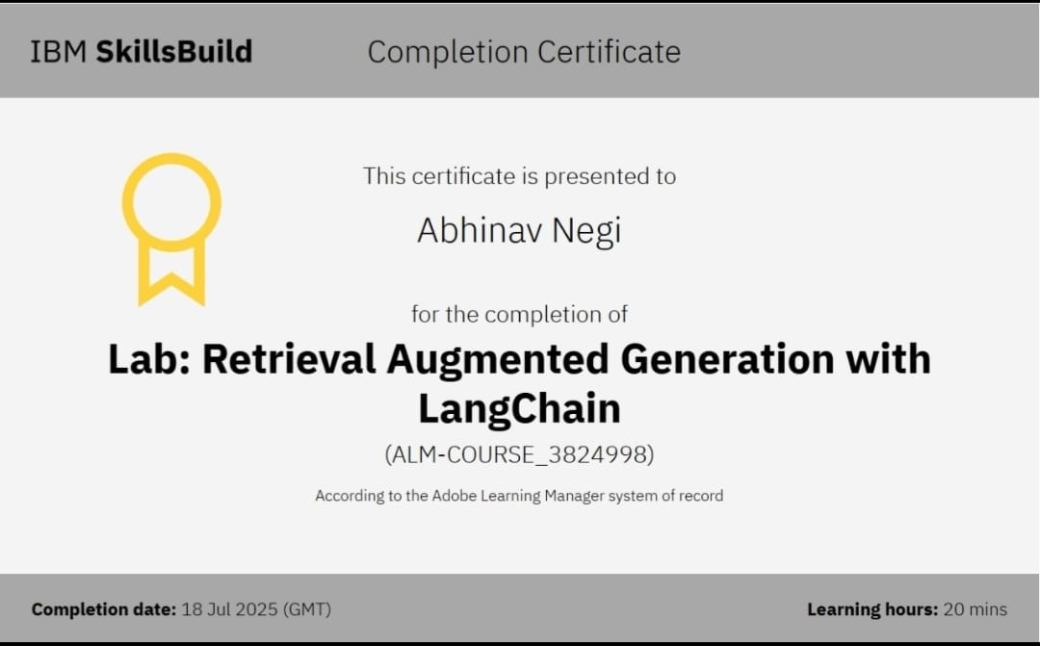
Lab: Retrieval Augmented Generation with LangChain

